Slide 1
EN 410 Energy Management
Gurubalan Annadurai
guru.a@iitb.ac.in

Slide 2
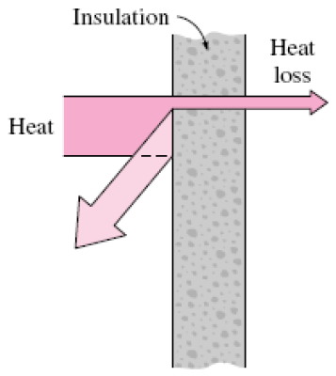
Insulation
Thermal insulations are materials or combinations of materials that are used primarily to provide resistance to heat flow
Most insulations are heterogeneous materials made of low thermal conductivity materials, and they involve air (low k and cheap) pockets
Payback period < 1year.

Slide 3
Benefits of insulation
Reduces overall energy consumption by reducing heat loss/gain
Personal safety (OSHA, any surface should be T<60℃)
Reducing temperature fluctuations
Avoiding condensation and thereby corrosion and mold prevention
Provides fire protection
Absorbs noise and vibration

Slide 4
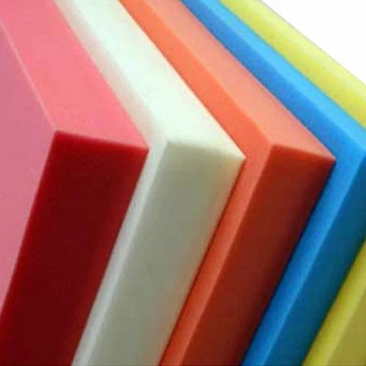
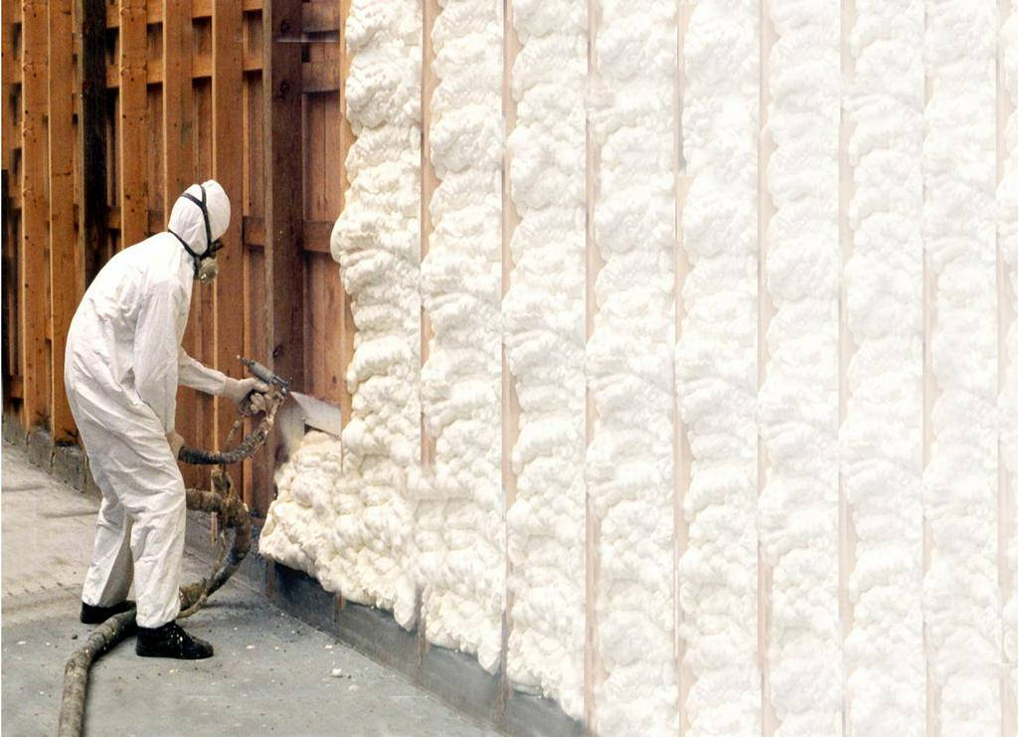
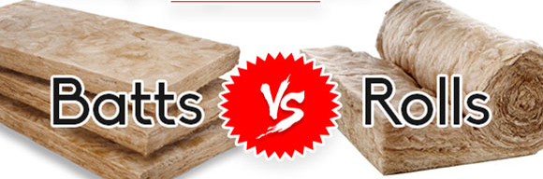
Types and materials
Low (<90℃), Medium (90-325℃) and High (>325℃)
Blanket - flexible fibers - comes in the form of batts or rolls - mineral (rock and slag) wool, plastic fibers, and natural fibers, such as cotton and sheep's wool
Foam - closed-cell and open-cell – cells are filled with air
Sprayed foam - isocyanate and polyol resin - 30-60 times its liquid volume – Air pockets
Polyurethane foam
Sprayed foam
Fiberglass

Slide 5
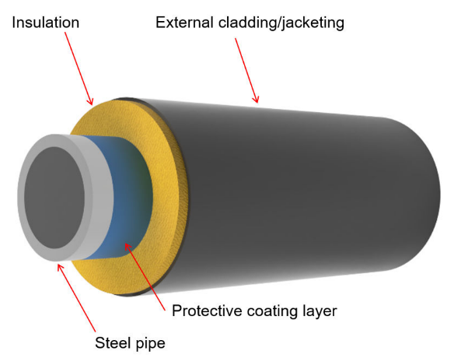
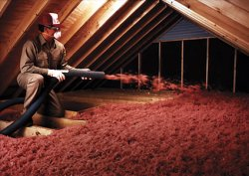
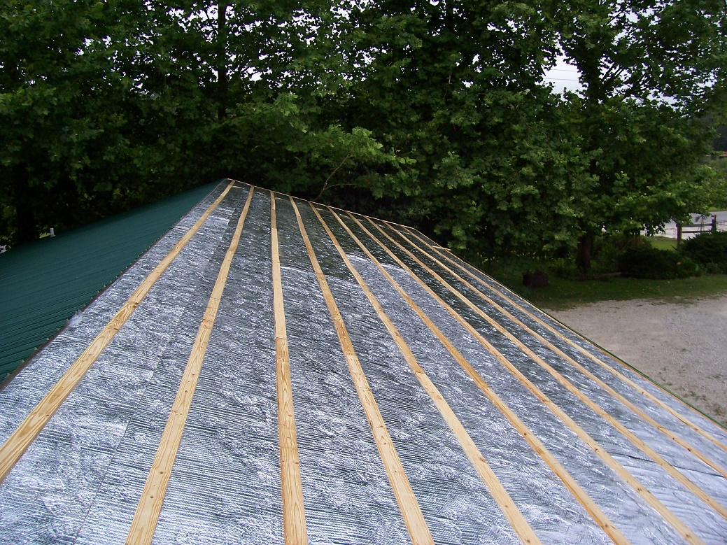
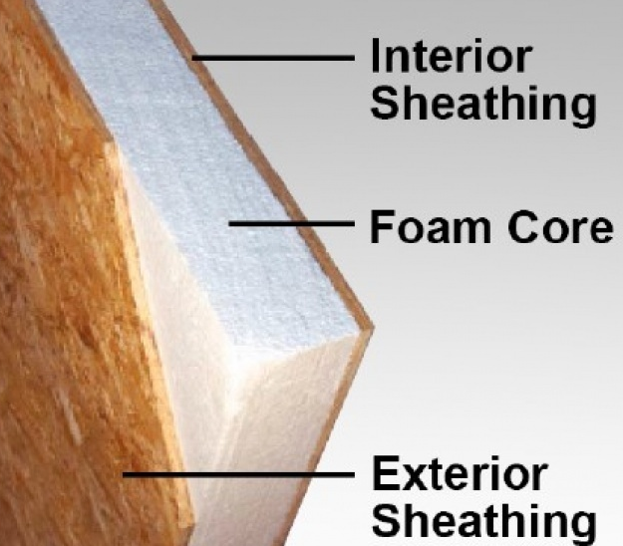
Types and materials
Loose fill - small particles of fiber, foam, or other materials, lower initial cost
Radiant barriers - incorporates reflective surfaces - typically aluminum foil- over conventional insulation material
Structural insulation
Structural insulation
Loose fill
Radiant barriers

Slide 6
Commonly used insulations
Subgroup | Insulation Material | Temperature °C | Thermal conductivity W / ( m.K )
Fibrous | Glass wool | -100-500 | 0.03-0.045
 | Rock wool | -100-750 | 0.033-0.045
Cellular | Calcium silicate | 300 | 0.045-0.065
 | Cellular glass | -260-430 | 0.04-0.06
 | Vermiculite | 700-1600 | 0.046-0.07
 | Ceramic | N.A. | 0.03-0.07
Foamed | EPS | -80-80 | 0.035-0.04
 | XPS | -60-75 | 0.03 0.04
 | PUR | -50-120 | 0.024-0.03
 | PIR | -20-100 | 0.018-0.028
Foamed, expanded | Cork | 110-120 | 0.037-0.050
 | Melamine foam | N.A. | 0.035
 | Phenolic foam | 150 | 0.022-0.04
 | Polyethylene foam | -40-105 | 0.033
Fibrous | Fiberglass | -4-305 | 0.033-0.04
 | Sheep wool | 130-150 | 0.04-0.045
 | Cotton | 100 | 0.035-0.06
 | Cellulose fibers | 60 | 0.04 0.045
 | Jute | N.A. | 0.038 0.055
 | Rice straw | 24 | 0.046-0.056
 | Hemp | 100-120 | 0.04-0.05
 | Bagasse | 160-200 | 0.046-0.055
 | Coconut | 180-220 | 0.04-0.05
 | Flax | N.A. | 0.03-0.045
Boards | Gypsum foam | N.A. | 0.045
 | Wood wool | 110-180 | 0.09
 | Wood fibers | 110 | 0.04-0.09
 | VIPS | N.A. | 0.002-0.008
 | Aerogel | N.A. | 0.013-0.014
What is the thermal conductivity of air?

Slide 7
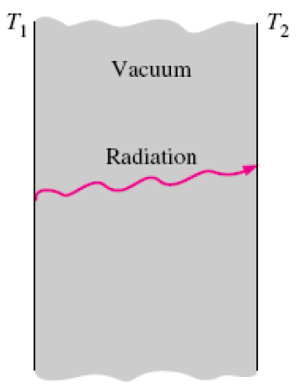
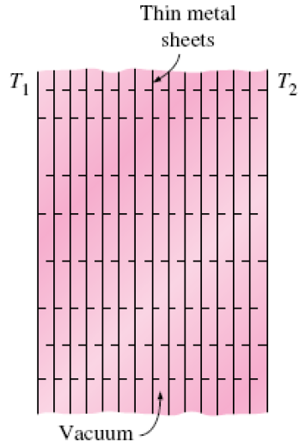
Super-insulators
Superinsulators are commonly used in space applications and cryogenics (temperatures below 100 K (−173°C) )
Is vacuum a good insulation?
Insulation against radiation heat transfer between two surfaces is achieved by placing highly reflective thin metal sheets
Space between the layers is evacuated to form a vacuum pressure to minimize conduction or convection heat transfer through the air space between the layers
Thermal conductivity < 2×10⁻⁵ W/m·°C, < air or other insulation by 1000 times.

Slide 8
Heat Transfer
Conduction (Fourier’s Law): Q = k A (ΔT/ Δx)
Convection (Newton’s Law): Q = h A ΔT
Electrical resistance = Voltage difference/Current
Thermal resistance = Temperature difference/Heat
Thermal resistance (ΔT/Q)
Conduction in slab = Δx/k A
Convection = 1/h A

Slide 9
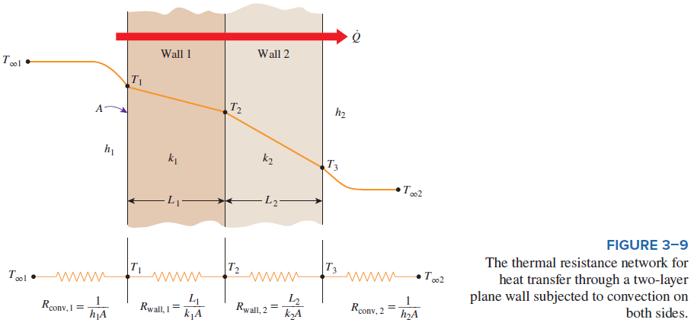
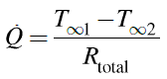
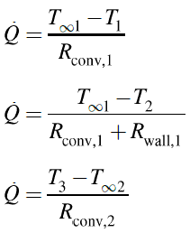
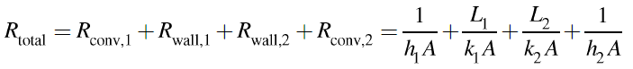
Plane Wall

Slide 10
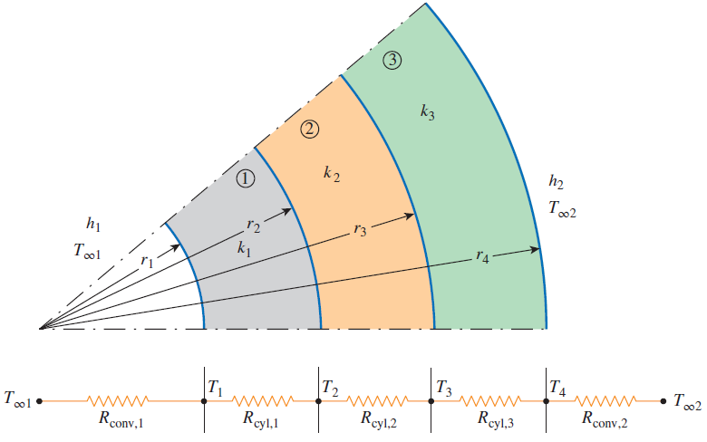
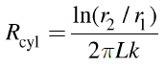
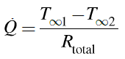
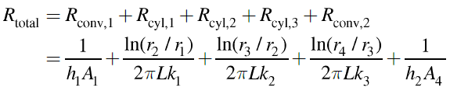
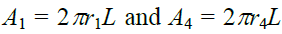
Cylindrical pipes

Slide 11
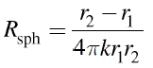
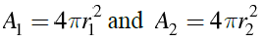
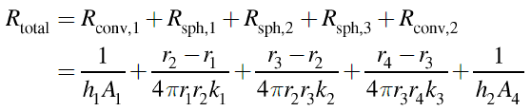
Spherical tanks

Slide 12
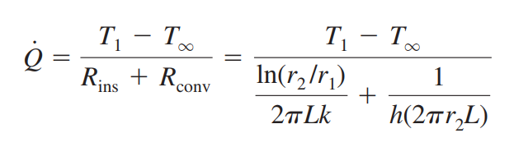
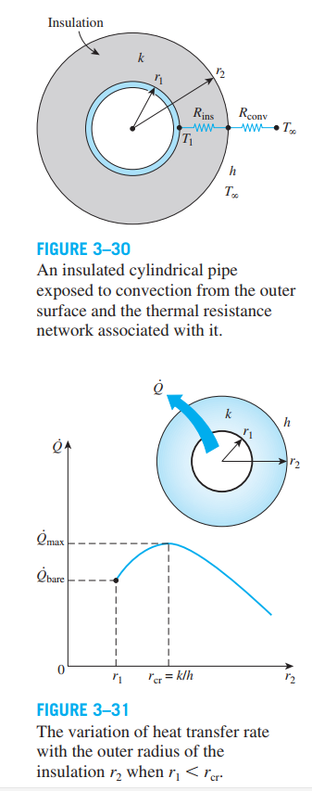
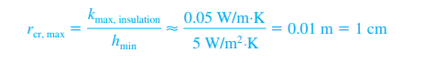
Critical insulation

Slide 13
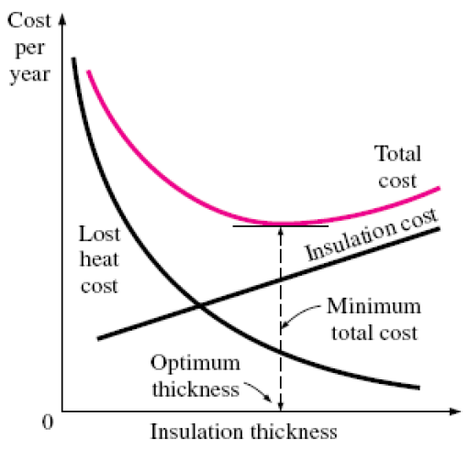
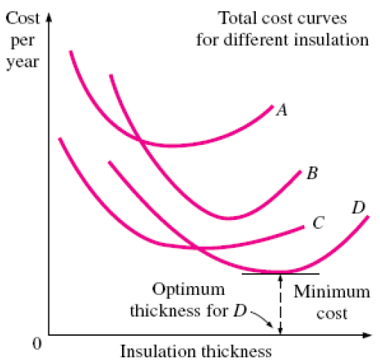
Optimum thickness of insulation

Slide 14
Insulation of a LNG tank
When the transportation of natural gas is not possible in a pipeline for economic reason, it is liquified (ρ = 425 kg/ m³, Cp = 3.475 kJ/kg.K) at about -160℃ and then transported in insulated tanks in ships.
Tank diameter is 4 m
Ambient temperature = 24℃
Ambient air heat transfer coefficient = 22 W/m².K
Tank is insulated with 5 cm thick super-insulator with k= 0.00008 W/m.K
Estimate how long it take it to rise to -158℃

Slide 15
References
https://www.energy.gov/energysaver/types-insulation#batts
https://www.nogapinsulation.com.au/comparing-insulation-batts-vs-rolls-which-is-better/
https://www.indiamart.com/proddetail/high-density-polyurethane-foam-12593989848.html
https://www.powerblanket.com/blog/spray-foam-insulation-properties-and-benefits/
https://www.daviddarling.info/encyclopedia/L/AE_loose_fill_insulation.html
https://rfoil.com/insulation-product/2200-reflective-insulation/
https://www.sips.org/what-are-sips
https://www.mdpi.com/2075-4701/12/4/561

